Slide 1
Tools Used For Code
IDE – JupyterLab
JupyterLab was used to make and run the program. JupyterLab was chosen because if it relevant tools and functionality.
Dataset – Kaggle
Kaggle has lots of useful dataset and we found an extensive dataset that fit out needs.

Slide 2
Image Formatting
For the program to function correctly all of the images need to be in a useable format.
This is done by cropping them down into a square. The dataset came with annotations as to where the dogs where in the images. This makes it easy for the program to crop in the wright places. E.G. Right, Left or Centre

Slide 3
Training
The program is trained by being given an image, breaking it down and then make a prediction on what category the image belongs to.
Initial this will provide low accuracy but every time it will improve slightly. This then iterates threw the dataset to improve. The code has a build in function that will stop the training if no improvement is happening.

Slide 4
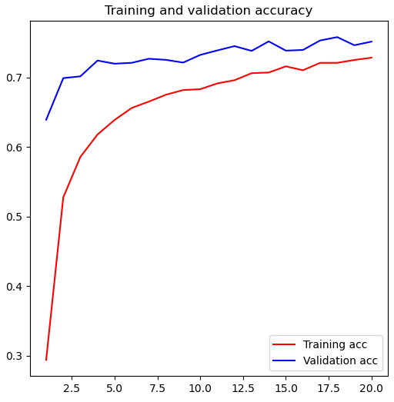
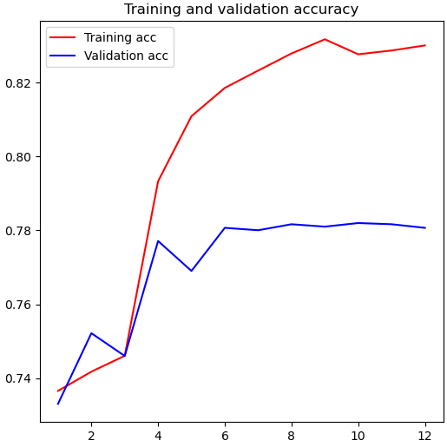
Training Graphs

Slide 5
GUI
The GUI for the program is designed to be simplistic to improve useability.
It has all the functionality you would expect and some added feature such as the ability to import training data from models previously trained. This greatly improves the scope of the program's capabilities.
The program also has different options based in if the images is a local file or off the internet. This preserves local files and improves ease of use.

Slide 6
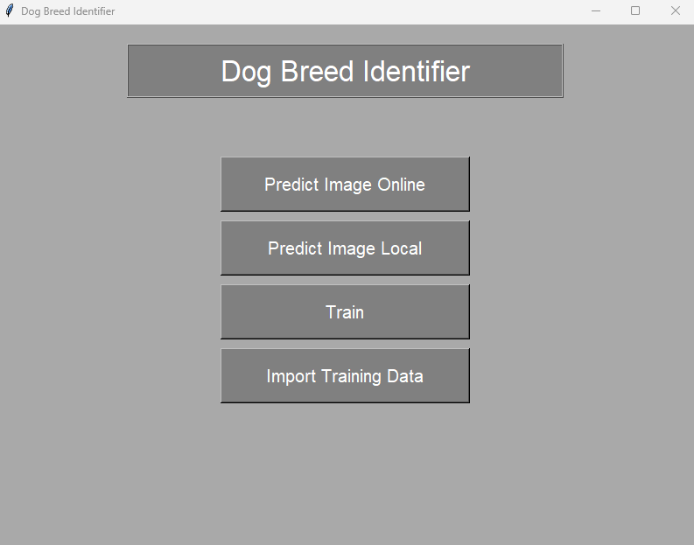
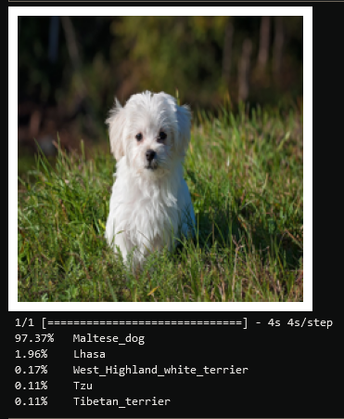
GUI Main Menu & Output

Slide 7
Program Demonstration

